Slide 1
Albemarle County Climate Policy:
Follow the Leader?
Albemarle County BOS Meeting
February 19, 2020
Charles G. Battig, M.S.,M.D.
Virginia Scientists and Engineers for Energy and Environment
CO2Coalition

Slide 2

Disastrous Consequences of
Consensus (“we are all in”) Climate Policy

Slide 3
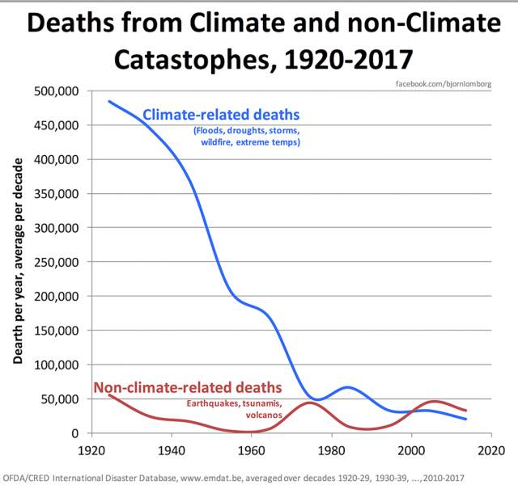
There Is No Climate Catastrophe In Need Of Political Madness Mandates

Slide 4
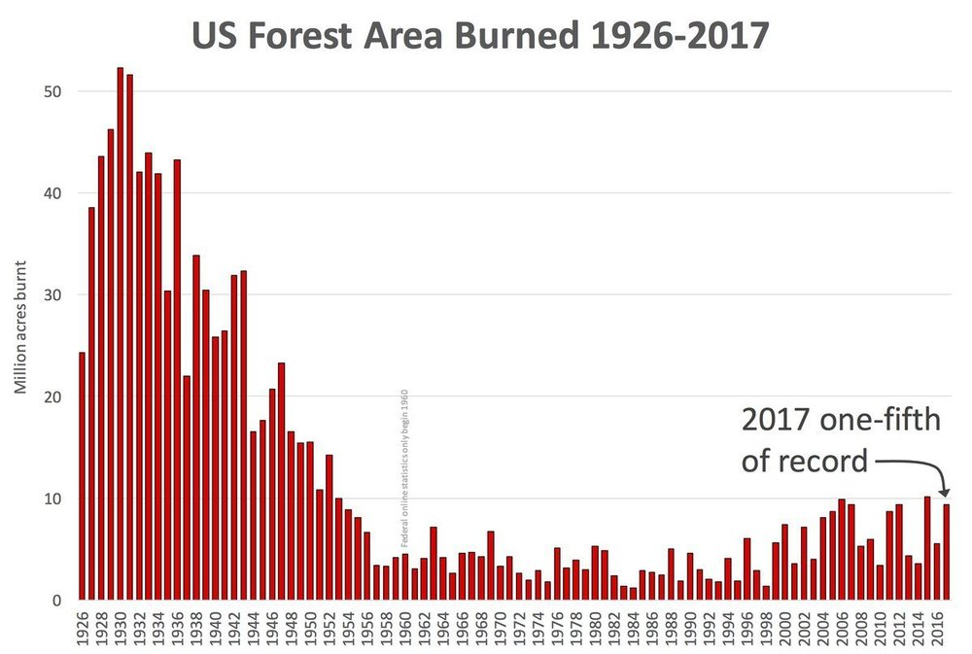
U.S. Forest Fire Area Has Been Decreasing

Slide 5
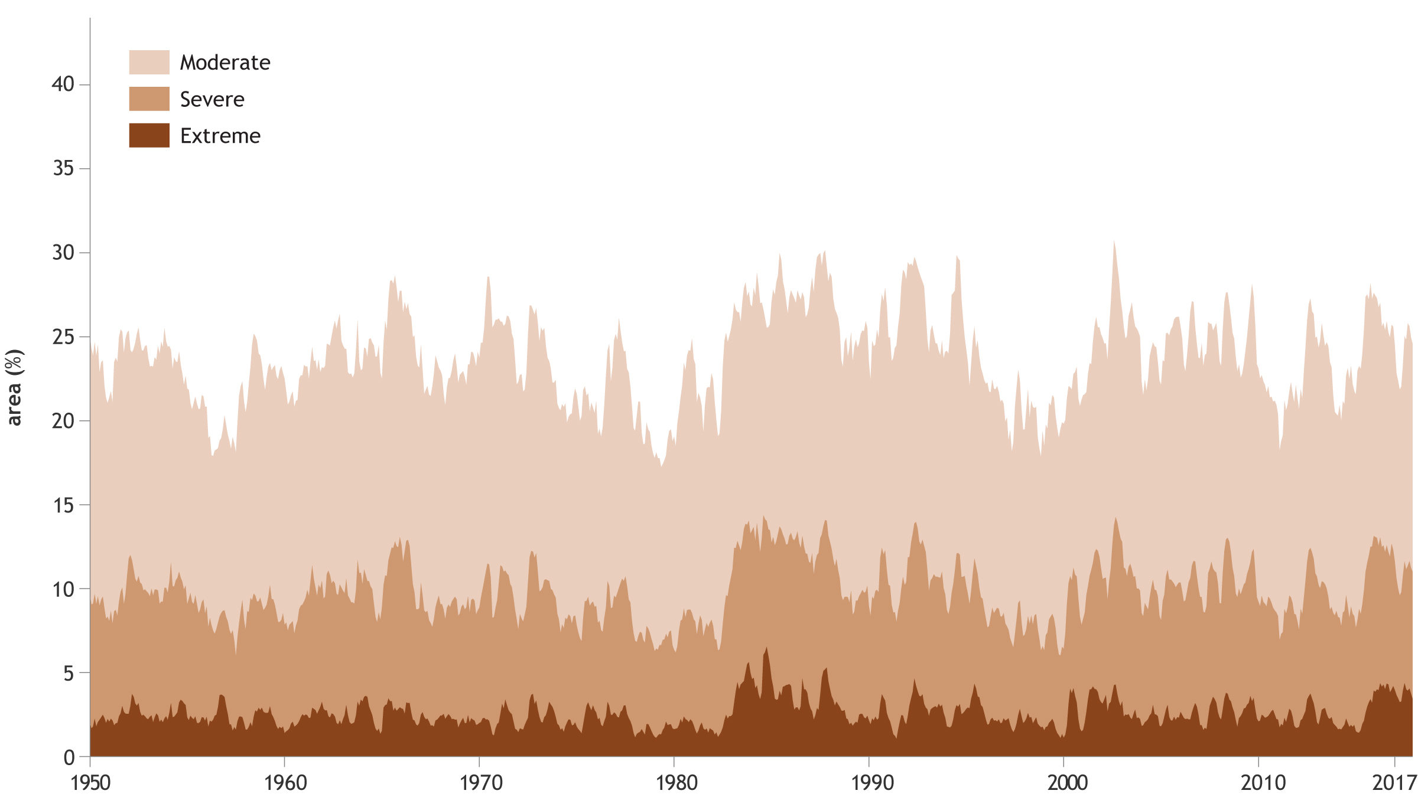
By Any Measure Droughts Are Not Getting More Severe
US National Oceanic and Atmospheric Administration (NOAA)

Slide 6
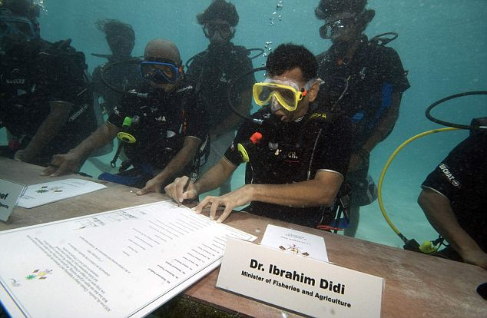

No, Sea Levels Have Not Submerged Pacific Islands As Predicted Ten Years Ago
2009…The Maldivian cabinet held a meeting underwater to highlight the need for action on climate change
2019... Following a push to improve hotel capacity, the Indian Ocean archipelago will play host to a dozen new hotels, with international brands all planning openings.

Slide 7
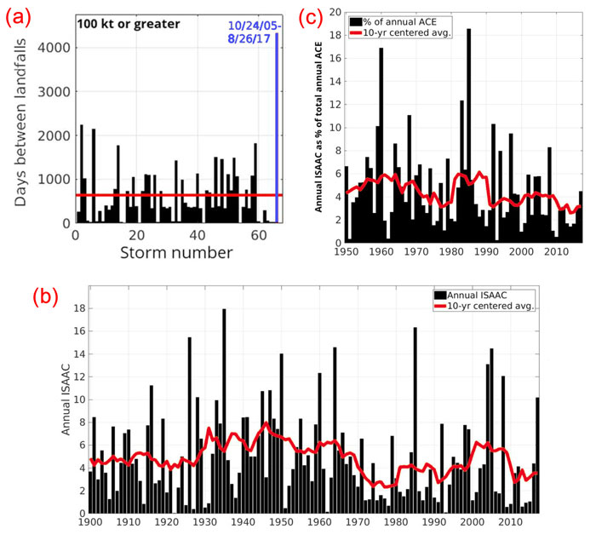
No Increase in U.S. Hurricane Frequency or Magnitude 1900-2019 https://www.masterresource.org/hurricane-harvey/no-significant-trend-in-u-s-hurricanes-over-the-period-1900-2017-article-review/

Slide 8
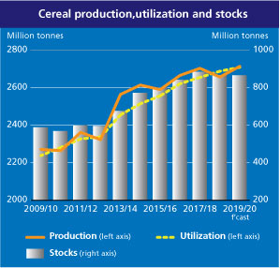
CO2 Up, World Food Production Up
CO2 Is Essential Plant Food http://www.fao.org/worldfoodsituation/csdb/en/

Slide 9
Shut Down All Fossil Fuel Use in All of Virginia
The saving in “global warming” in 2050 will be:
0.0016 degree C
http://scienceandpublicpolicy.org/images/stories/papers/originals/state_by_state.pdf

Slide 10

Hear No Science, See No Science, Speak No Science…County Policy?
But “We are still in”… Science Denial

