Slide 1
County BOS Concern For The Environment Is Well Founded
As Renewable Energy Sources Scar the Landscape
Albemarle County BOS Meeting
March 4, 2020
Charles G. Battig, M.S.,M.D.
Virginia Scientists and Engineers for Energy and Environment
CO2Coalition

Slide 2
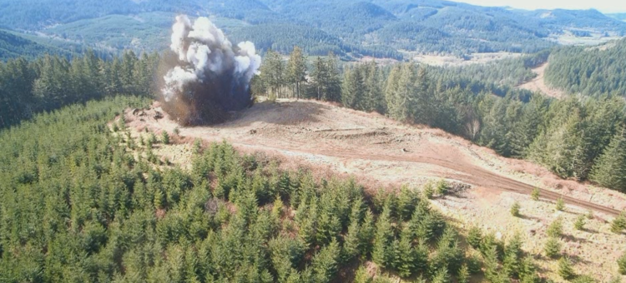
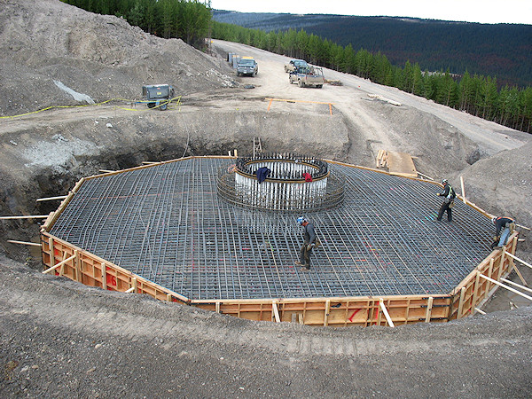
Environmental Destruction To Construct Unreliable Wind Power
Native Habitats Destroyed
For Just A Single Wind Turbine Tons of Steel and Concrete Trucked In
https://savethehuronmountains.org/2018/06/27/mountain-tops-blasted-to-make-room-for-turbines/
http://www.canasteel.com/images/projects/3b.jpg

Slide 3
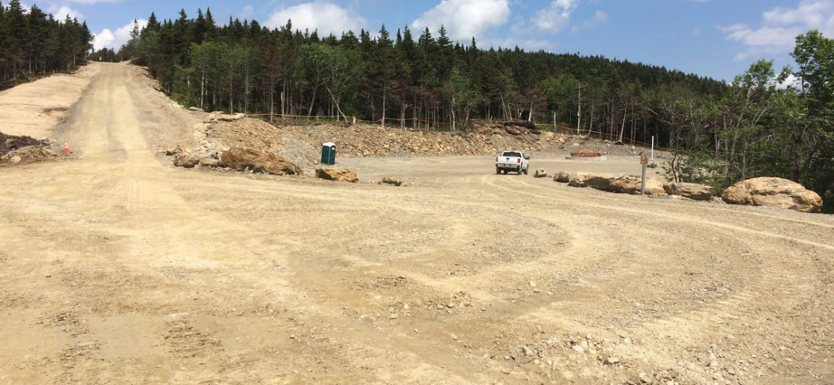
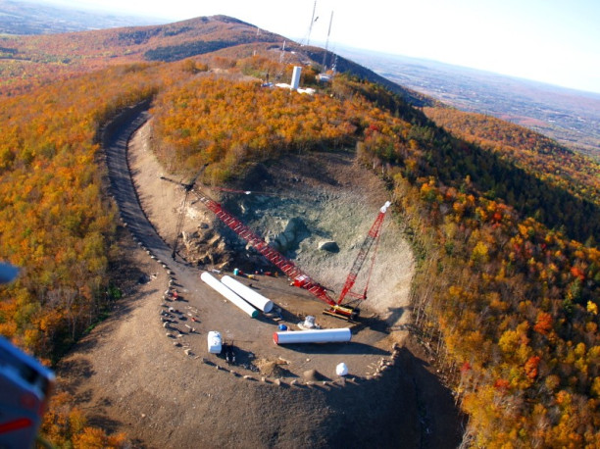
Wind Turbine Construction Carving Roads In Virgin Forests For Transport of Massive Amounts of Concrete and Steel And Subsequent Maintenance
https://savethehuronmountains.org/2018/06/27/mountain-tops-blasted-to-make-room-for-turbines/

Slide 4
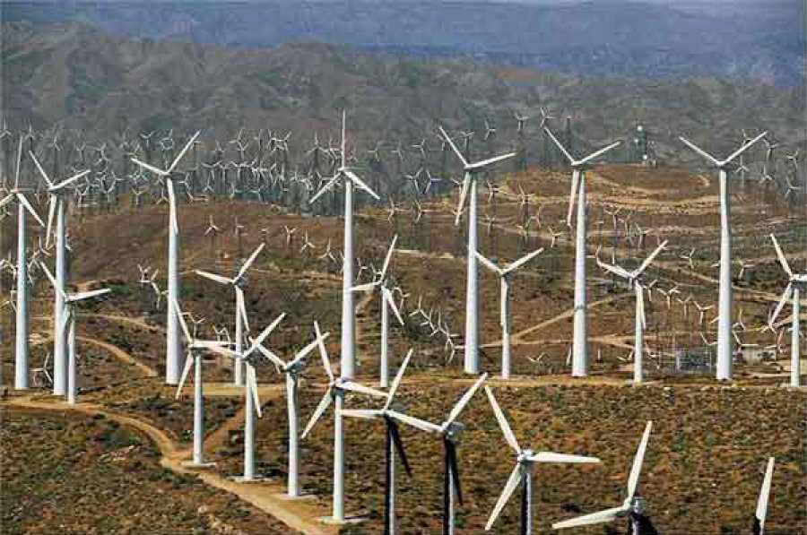
Harvard Study Finds Wind Turbines Warm The U.S.
https://www.cfact.org/2020/02/06/harvard-study-finds-wind-turbines-warm-the-u-s/

Slide 5
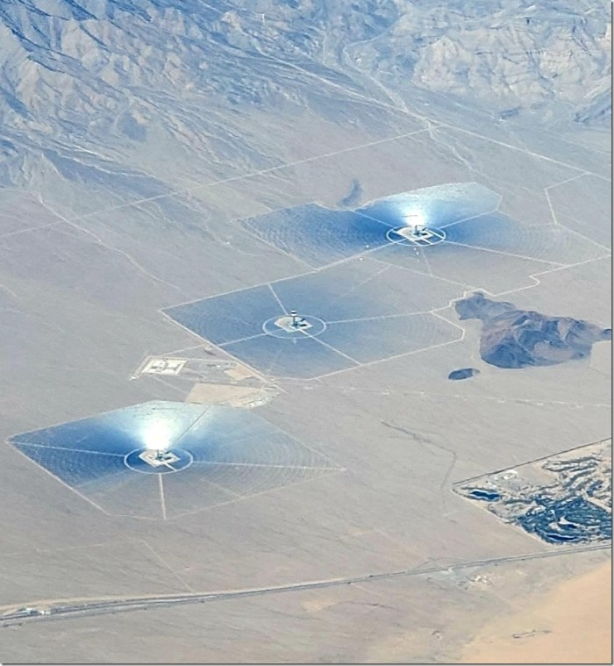
The Failed $2.2 Billion Ivanpah Solar Power Facility Near Las Vegas Produces A Blinding White Light To Airplane passengers And Incinerates Birds In Mid-Flight
Ivanpah solar energy facility in California’s Mojave Desert on 12 February 2020, taken from about 33,000 ft. altitude. Dr. R. Spencer

Slide 6
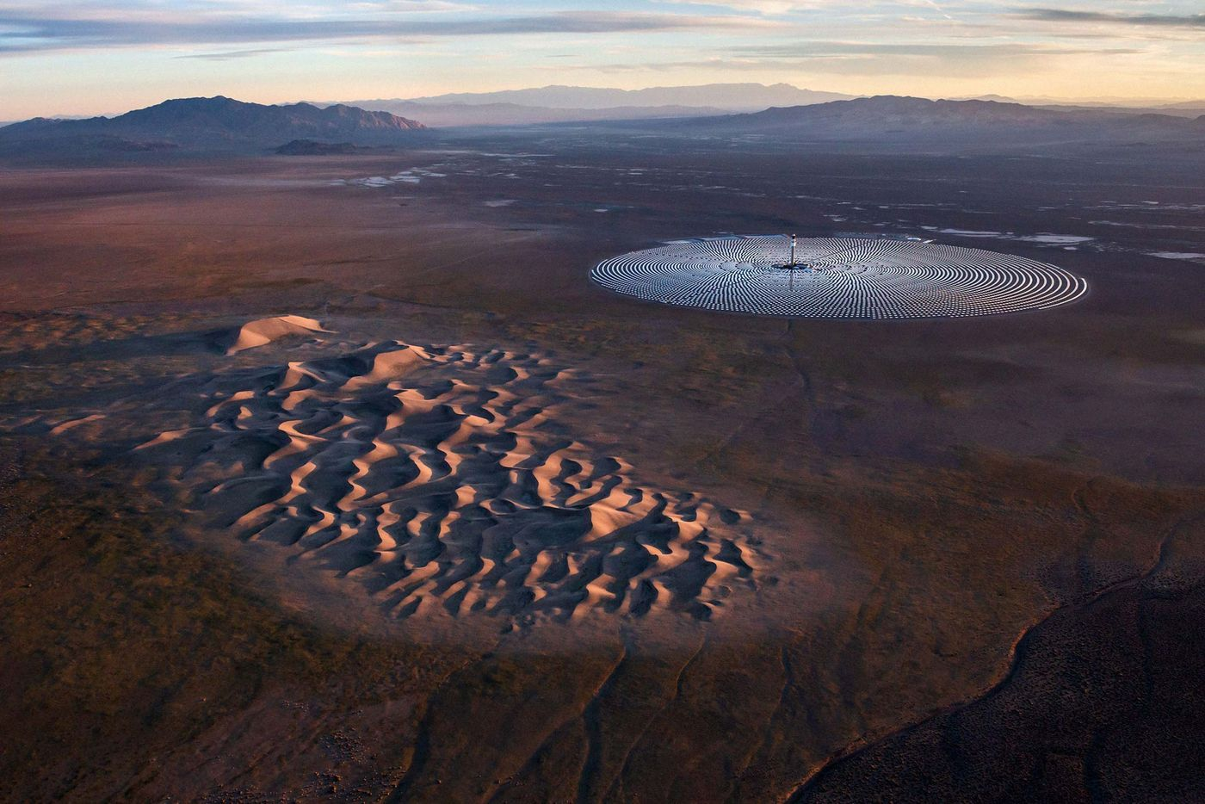
$1 Billion Crescent Dunes Solar Plant Was Obsolete Before It Ever Went Online
Aerial photograph of the Crescent Dunes Solar Energy Project near Tonopah, Nevada.
PHOTOGRAPHER: JAMEY STILLINGS

Slide 7
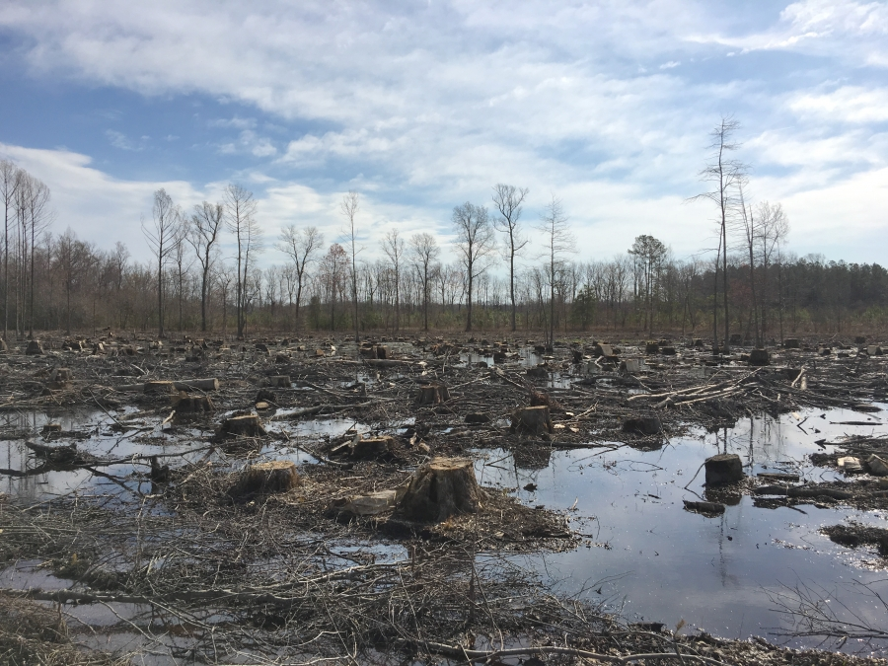
Biomass Based Enviva Owns And Operates Seven Plants In Southeastern United States Producing Over 3 Million Metric Tons Of Wood Pellets Annually Exported Primarily To Power Plants In The United Kingdom And Europe
https://www.pri.org/stories/2018-06-20/uk-s-move-away-coal-means-they-re-burning-wood-us

Slide 8
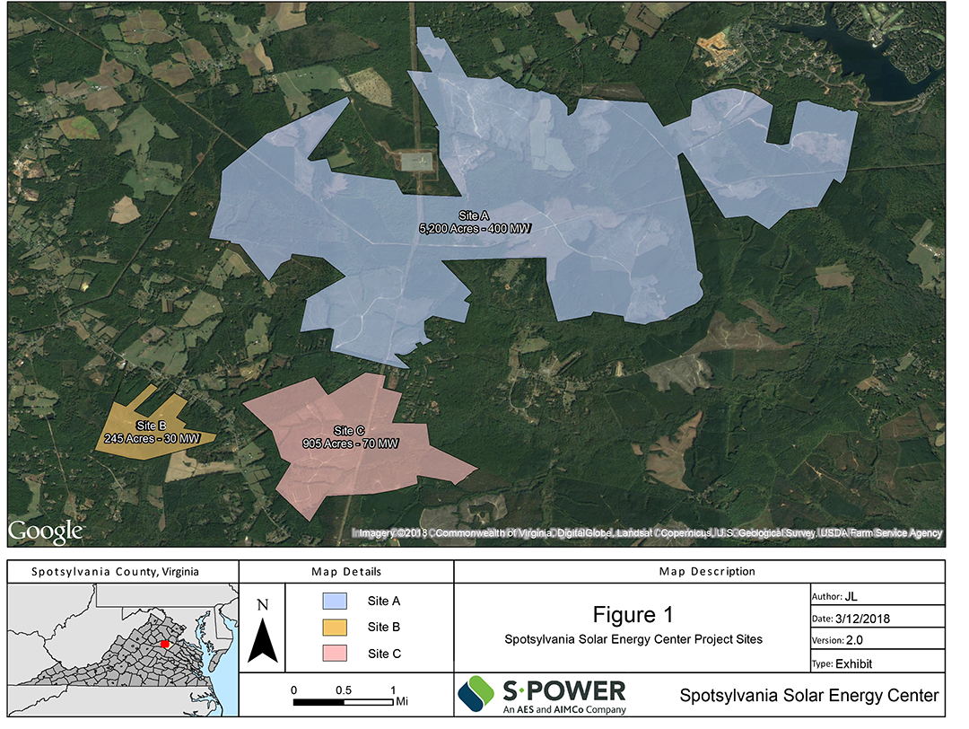
An Ocean of Reflecting Solar Panels Killing Natural Light to Native Ground Habitats and Leaching Toxic Chemicals Right Here In Virginia

Slide 9
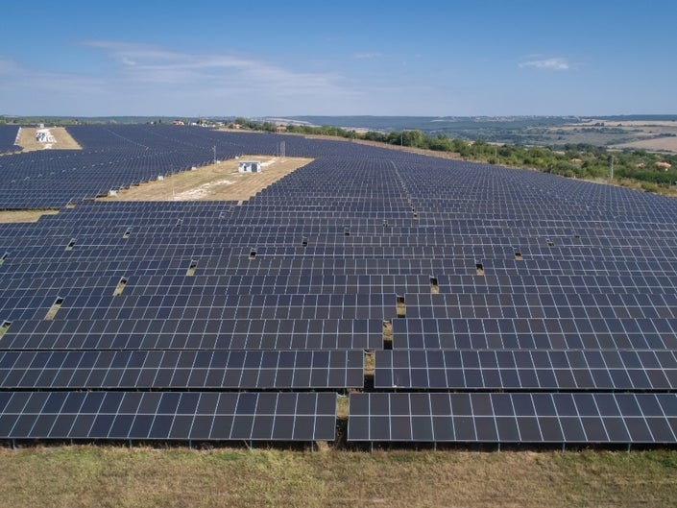
The Spotsylvania Solar Energy Center (Project) Is A “500-Megawatt” Solar Project Located In Western Spotsylvania County, Virginia. The Site Consists Of Three Non-contiguous Boundaries Encompassing Nearly 6,350 Acres and Produces Electricity Only When The Sun Shines
https://patch.com/virginia/fredericksburg/solar-farms-construction-upsets-spotsylvania-residents-report

Slide 10
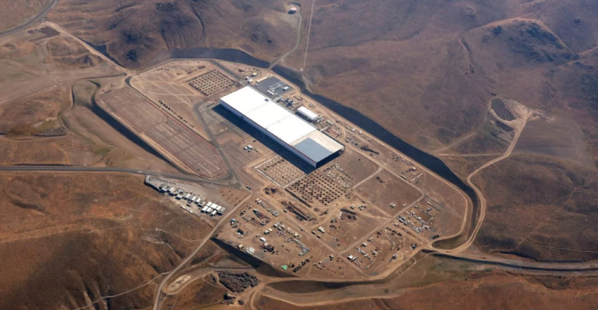
2,800 Acre Tesla Gigafactory Outside Sparks, Nevada https://arizonadailyindependent.com/2017/01/05/battery-cell-production-begins-at-the-gigafactory/

Slide 11
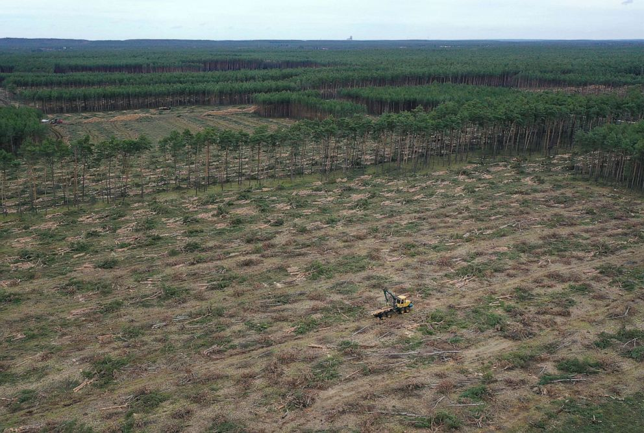
Nearly 800 Acres of German Virgin Forest Cleared For Tesla Gigaplant
https://abcnews.go.com/Business/court-asks-tesla-temporarily-stop-cutting-trees-site/story?id=69029497

Slide 12
From 2000 to 2019 Scotland Cuts Down 13 Million Trees Covering 17,283 Acres For Wind Power
“Renewable developments on Scotland’s national forests and lands, which is managed on behalf of Scottish Ministers by Forestry and Land Scotland. The area of felled trees in hectares, from 2000 (the date when the first scheme was developed, is 6,994 hectares [70 km², 17,283 acres]. Based on the average number of trees per hectare, of 2000, this gives an estimated total of 13.9M.”
https://www.wind-watch.org/documents/more-than-13-9-million-trees-felled-in-scotland-for-wind-development-2000-2019/

Slide 13
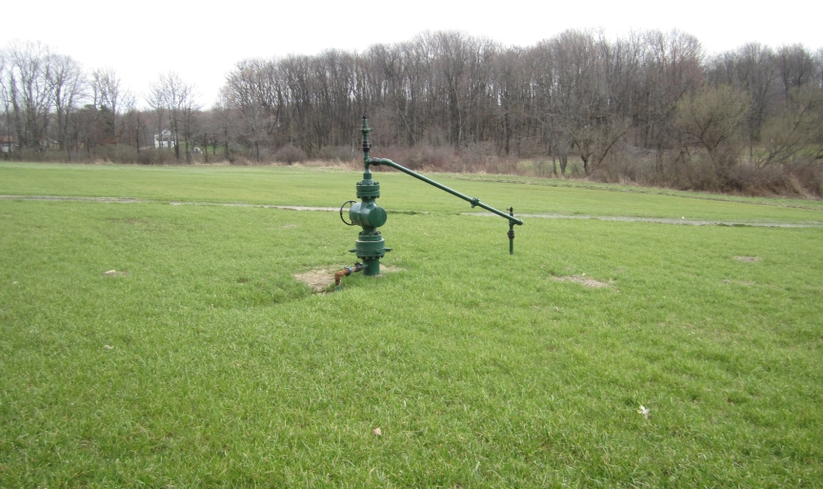

Compare Footprint of Gas Fracking Wellhead And Underground Path To That Of Solar Panels And Wind Turbines…Natural Gas Provides Energy Day and Night
Buried Pipeline After Construction Restoration
Gas Well-Head
https://4.bp.blogspot.com/-K7frHANy_tE/Tegi0zOoqkI/AAAAAAAAAEA/jd43YY1BEd8/s1600/Wellhead.jpg

Slide 14
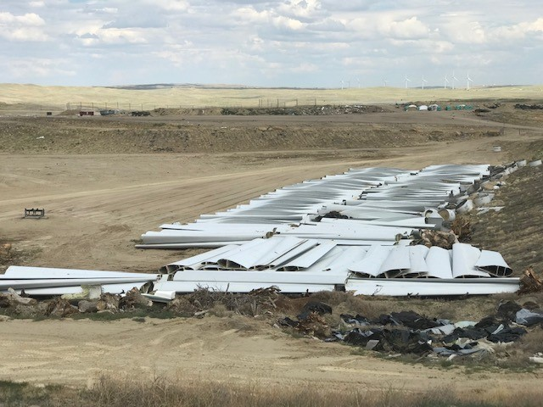
Worn Out Turbine Blades Are Now Major Disposal Hazard For The Environment
https://cowboystatedaily.com/2019/08/07/wind-turbine-blades-being-disposed-of-in-casper-landfill/

Slide 15
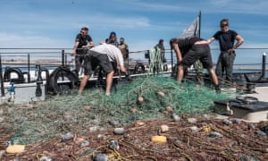
From Where Does Ocean Plastic Originate?
Where Does “Recycled” Plastic Waste Finally Show Up?
A recent study of the “great Pacific garbage patch”, an area of plastic accumulation in the north Pacific, estimated that it contained 42,000 tones of mega-plastics, of which 86% was fishing nets.
Ocean Conservancy: “roughly 60% of all the plastic in global waters originates in five countries: China, the Philippines, Thailand, Indonesia, and Vietnam.”
https://www.theguardian.com/environment/2019/nov/06/dumped-fishing-gear-is-biggest-plastic-polluter-in-ocean-finds-report

