Slide 1
Albemarle County and The Commonwealth Both Committed to Politically Driven Climate Policies Lacking Scientific Validation
While A True Crisis Sweeps The World
Albemarle County BOS Meeting
April 1, 2020
Charles G. Battig, M.S.,M.D.
Virginia Scientists and Engineers for Energy and Environment
Policy Advisor Heartland Institute
CO2Coalition

Slide 2
Wuhan Coronavirus/COVID-19
What A “Real Existential Crisis” Looks Like
Acute Respiratory Distress Syndrome (ARDS): A real crisis…first described in 1967…a rapid onset of a widespread inflammation of the lungs, leaving patients drowning in their own secretions At the time, as an attending anesthesiologist, I treated those intensive care patients with intubation, ventilator support…much as is done now.
The much-lamented climate “existential crisis” over one degree of global warming is not in the same league… It is a manufactured fear of normal variations of weather, magnified by climate change computers likely programmed with faulty input data to the satisfaction of political, environmental extremists, and financial profiteers…but it can be responsible for unnecessary deaths. The flu season is a cold weather phenomenon…welcome the warming.

Slide 3
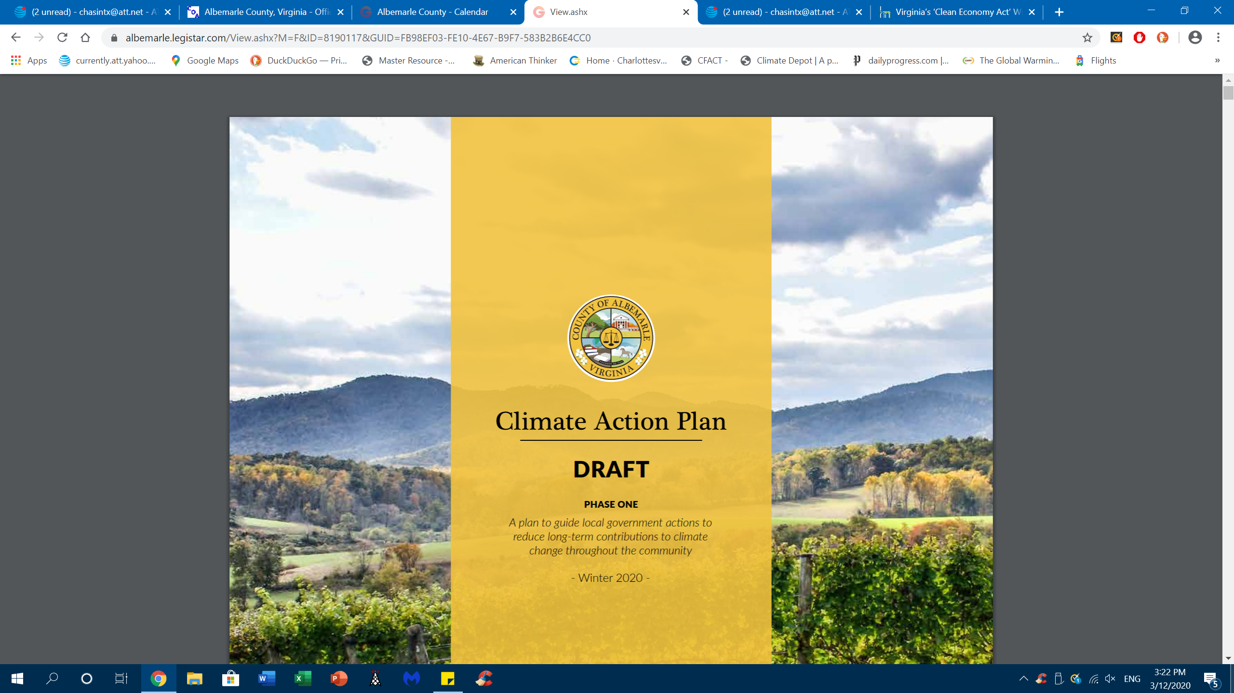
Forty-One Pages With Zero Climate Impact
No Cost Benefit Analysis…how much will these policies impact climate change, how will success be measured, and at what taxpayer cost in dollars and loss of freedoms?
Depends on outdated political consensus science of United Nations IPCC and outdated references
Ignores latest scientific data to the contrary; U.N. IPCCC AR6 is underway with lowered computer predictions for temperature change
Ignores fact that the human contribution to global climate change can not be distinguished from natural background changes
Get used to bicycle riding, summer and winter
Electric cars = Emission Elsewhere Luxury Cars
Ignores Study Showing That If All of Virginia Abandons All Fossil Fuel Use The Temperature Savings By 2050 Would be:
0.0016 Degree C

Slide 4
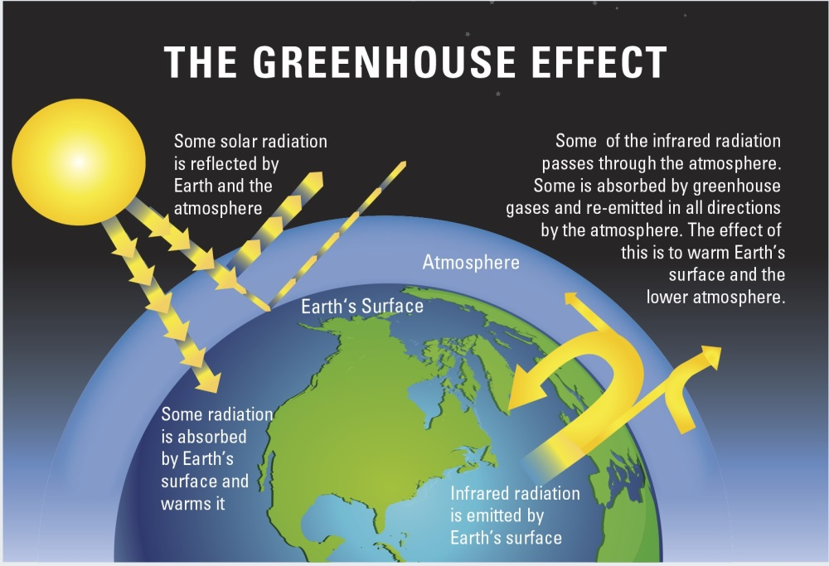
Page 12 of County Action Plan Illustrates Limited Understanding
https://royalsociety.org/topics-policy/projects/climate-change-evidence-causes/basics-of-climate-change/

Slide 5
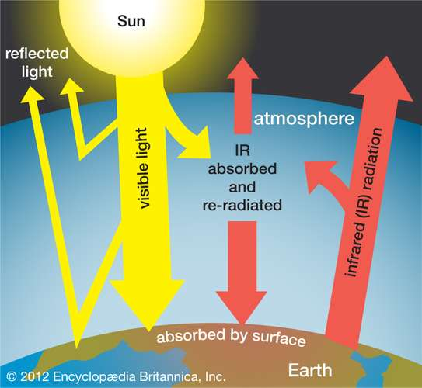
“Greenhouse effect, a warming of Earth’s surface and troposphere (the lowest layer of the atmosphere) caused by the presence of water vapour, carbon dioxide, methane, and certain other gases in the air. Of those gases, known as greenhouse gases, water vapour has the largest effect.” UVA’s M. Mann
https://www.britannica.com/science/greenhouse-effect

Slide 6
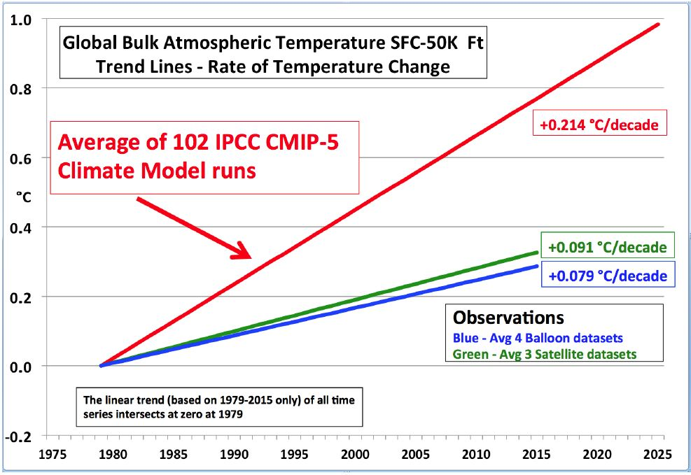
U.N. IPCC Climate Computers “Predicted” 3X The Actual Warming Over A 50 Year Period
Climate Change Scare Stories Are Based On These Faulty Computer Assumptions and Faulty Predictions

Slide 7
“NATURE” (January 29, 2020)…Emissions –‘Business As Usual’ Computer Modeling Story Is Misleading
RCP8.5 paints a dystopian future that is fossil-fuel intensive and leading to nearly 5 °C of warming by the end of the century^{2,3}. It has been widely used by some experts, policymakers and the media as a likely ‘business as usual’ outcome, implying that it is probable in the absence of stringent climate mitigation. The media then often amplifies this message, sometimes without communicating the nuances. This results in further confusion because many climate researchers are not familiar with the details of these scenarios in the energy-modelling literature.
RCP= Representative Concentration Pathway; RCP8.5 assumes the most extreme CO2 effects
https://www.nature.com/articles/d41586-020-00177-3

Slide 8
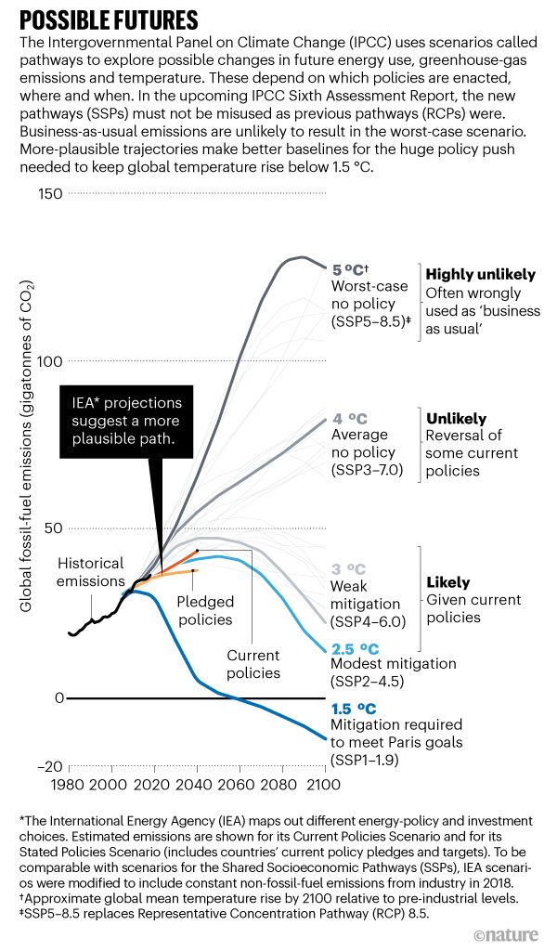
Climate-impact Studies Using Models Developed For U.N. IPCC Assessment Report 6 (AR6- 2022) Should Include Scenarios That Reflect More-Plausible Outcomes…NATURE

Slide 9
Green-Virtue-Signaling Handbook
If proposals make you feel better even if there is no “settled science” to prove that you will have any effect on the climate, please do so voluntarily.
Do not impose taxes/incentives to mandate useless and expensive intrusions on personal choice
Will BOS members please notify the public when they start bicycling to work and to and from the supermarkets?

Slide 10
Commonwealth Political Climate Bill:
“Virginia Clean Economy Act” 2020
Senate Majority Leader Dick Saslaw: Virginia has “a climate problem, and you can’t fix it for free.”…but you can try by taxing the public
The State Corporation Commission has said Dominion Energy, which owns the state's largest electric utility, will collect tens of billions of dollars from Virginia ratepayers to meet the bill's requirements.
Bill promotes environmentally damaging and expensive off-shore wind and land intensive solar
Bill uses tax dollars to subsidize legislative political agenda, crony capitalism, and income redistribution while disregarding scientific fact and the historical climate record
Climate impact will be unmeasurable, but unnecessary economic burden will be painful

Slide 11
Democratic Legislated Environmental Destruction in Virginia Bill
Poor timing and poor policy: Wind (and solar) energy would be dependent on mostly Chinese or Chinese owned foreign materials, components and finished products.
In place of reliable fossil-fueled electricity, Virginia companies would erect offshore wind turbines – 433 to 866 GE 12 MW Haliade-X turbines manufactured near Wuhan, China…each 850 feet tall, 27 miles off Norfolk-Virginia Beach. The eventual number is projected to reach 2,500. Where is the environmental impact study? Birds, sea-life?
Saltwater and storms will degrade the turbines efficiency and reduce their nameplate electrical output…hurricanes can prompt their complete shut-down and loss of electric power to industry and residential consumers.

Slide 12
Additional Environmental Consequences Of The “Virginia Clean Economy Act 2020”
To meet the legislated 16,100 MW of solar electricity, Virginia would plaster over an estimated land area 18 times that of Washington, DC with Chinese solar panels, inflicting 700,000 acres of environmental disruption, shedding toxic waste as they deteriorate over time.
In place of reliable fossil-fuel powered back-up, 36,500 half-ton Tesla 85-kilowatt-hour battery packs are proposed, requiring lithium and cobalt sourced from places with little or no environmental controls, and reported child-labor abuse.
Where will thousands of tons of worn-out solar panels and wind turbine parts be disposed of eventually?
The revered Appalachian Trail will be crisscrossed by new, transmission towers and overhead power lines in place of buried gas pipe-lines.

Slide 13
Yes, “We Are All In”…For It

